Slide 1

ML Models
Prepared by: khaled Almir
Supervisor: Dr. Natasha Alkhatib
Position: AI Red team intern at VersifAI

Slide 2
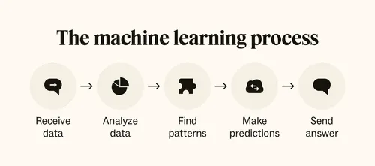
What is ML ?
Machine Learning is a field of Artificial Intelligence (AI)
ML is the process of training a piece of software, called a model to make useful predictions or generate content (like text, images ..) from data.

Slide 3
What is a Machine Learning Model
A machine learning model represents the relationship discovered between the input data (features) and the output (label or target).
During training, the model learns from data and can then predict or decide on new inputs.
Example;
  Input (X): House size, number of rooms, location
  Label (Y): House price
  The ML model learns the mathematical relationship between these features and the price.
  Then it can predict the price of a new house based on its features.

Slide 4
Type of ML
ML
Supervised
Unsupervised
Reinforcement
Generative AI
Regression
Binary classification
Multi class classification

Slide 5
Supervised Learning
Supervised Learning is a type of ML where the model learns from labeled data to predict outputs for new inputs.
Key Concepts:
  Dataset: Collection of examples (features + label)
  Features: Input values
  Label: Output value the model predicts
  Labeled Examples: Have features & label

Slide 6
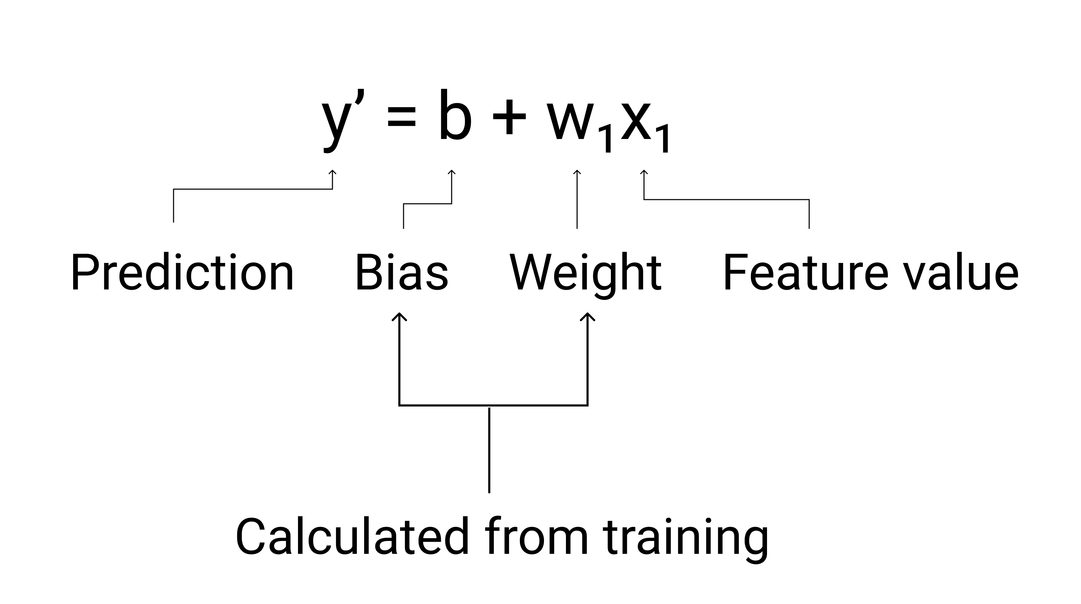
Linear regression
Linear Regression is a statistical technique that models the relationship between features and a numerical label (output).

Slide 7
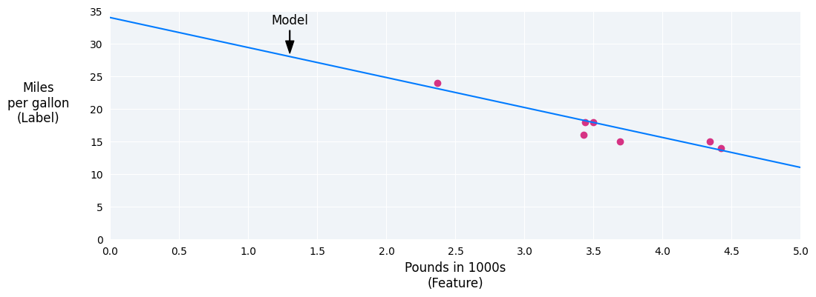
Linear regression

Slide 8
How linear regression work ?
Provide Data:
  Feature(s): Input values (e.g., house size x₁)
  Label: Real output we want to predict (e.g., house price y)
Model Prediction:
  Uses the equation
  b: bias (baseline)
  w₁: weight
Calculate Error:
  Compare predicted y′ with real y → Error = y − y′

Slide 9
How linear regression work ?
Adjust Parameters:
  Update b and w₁ to reduce error
  Repeat for all examples (epochs) until error is minimized
Result:
  Final b and w₁ represent the learned relationship
  Model can now predict new, unseen data using the same equation

Slide 10
How linear regression work ?
How does the model know how wrong its predictions are?
How it try to predict and how it work ?
Are there any other parameters that affect training?

Slide 11
How does the model know how wrong its predictions are?
It know using Linear regression-Loss
Loss is a numerical metric that describes how wrong a model's predictions are
Measures the distance between the model's predictions and the actual labels.
The goal of training a model is to minimize the loss, reducing it to its lowest possible value

Slide 12
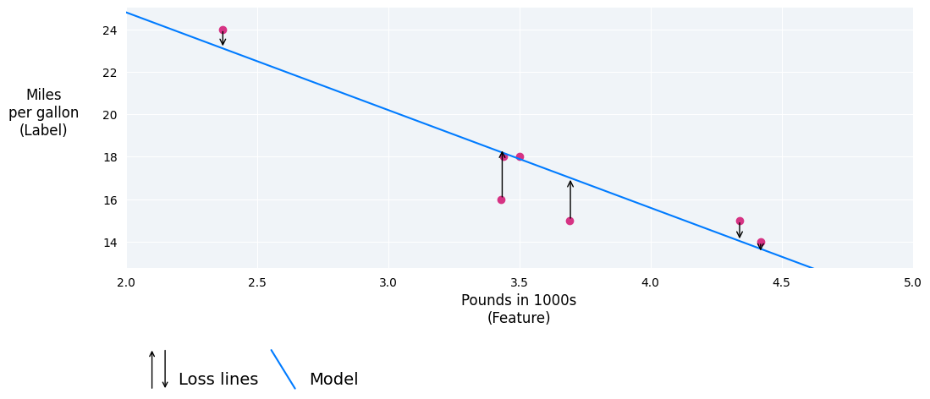
How does the model know how wrong its predictions are?

Slide 13
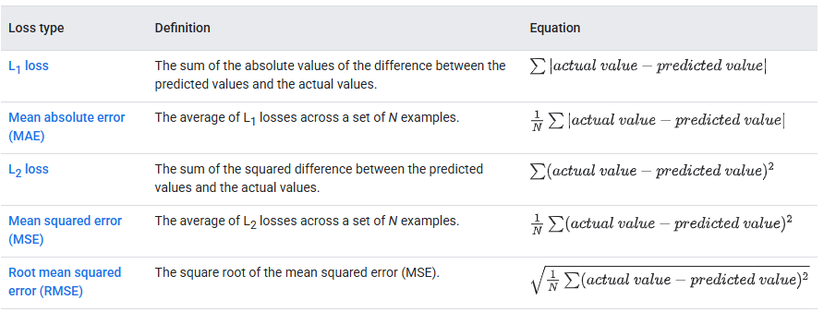
How does the model know how wrong its predictions are?

Slide 14
How does the model know how wrong its predictions are?
Prediction
  23.1
Actual value
  26
L2 loss
  (26-23.1)^2=8.41
Choosing a loss
  Deciding whether to use MAE or MSE can depend on the dataset and the way you want to handle certain predictions.

Slide 15
How it try to predict and how it work ?
Gradient descent
is a mathematical technique that iteratively finds the weights and bias that produce the model with the lowest loss
Gradient descent finds the best weight and bias by repeating the following process for a number of user-defined iterations.
Model convergence and loss curves
  When training a model, you'll often look at a loss curve determine if the model has converged
  The loss curve shows how the loss changes as the model trains.

Slide 16
How it try to predict and how it work ?
The model begins training with randomized weights and biases near zero, and then repeats the following steps:
  Calculate the loss with the current weight and bias.
  Determine the direction to move the weights and bias that reduce loss.
  Move the weight and bias values a small amount in the direction that reduces loss.
  Return to step one and repeat the process until the model can't reduce the loss any further.

Slide 17
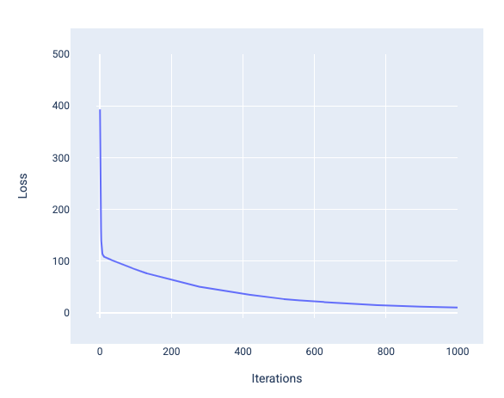
How it try to predict and how it work ?

Slide 18
Are there any other parameters that affect training?
“Move the weight and bias values a small amount in the direction that reduces loss”
The Hyperparameters are variables that control different aspects of training
parameters are the variables, like the weights and bias, that are part of the model itself
hyperparameters are values that we control

Slide 19
Are there any other parameters that affect training?
Learning rate
Batch size
Epochs

Slide 20
Are there any other parameters that affect training?
Learning rate
  floating-point number you set that influences how quickly the model converges.
  Its controls the additional value of weight and bias
  If the learning rate is too low, the model can take a long time to converge.
  If the learning rate is too high, the model never converges but instead bounces around the weights and bias that minimize the loss.

Slide 21
Are there any other parameters that affect training?
Batch size
  Batch size is a hyperparameter that refers to the number of examples the model processes before updating its weights and bias.
  If batch size = 1, the model updates after every single example → this is Stochastic Gradient Descent (SGD)
  If batch size = total dataset size , the model updates once per full pass through the data → this is Full-Batch Gradient Descent.
  If batch size = some number between 1 and total dataset size, the model updates after each small group of examples → this is Mini-Batch Gradient Descent.

Slide 22
Are there any other parameters that affect training?
Epochs
  How many time we want to repat the taring
  For example, if a training set has 1,000 examples and a mini-batch size of 100 examples, it will take the model 10 iterations to complete one epoch.
  If we put Epochs =2 ➔ need 20 iterations to finish the training

Slide 23
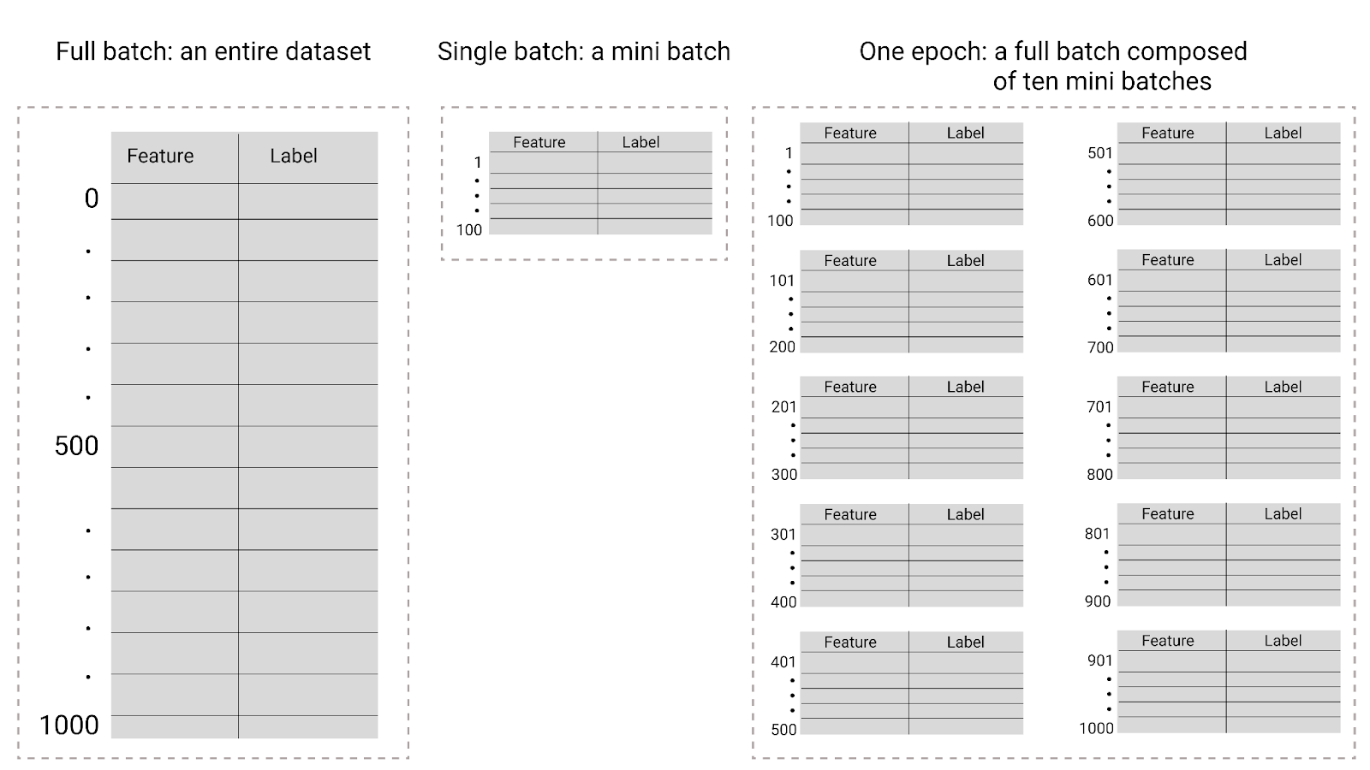
Are there any other parameters that affect training?

Slide 24
logistic regression
That is designed to predict the probability of a given outcome.
Linear Regression gives any real number as output (like 2.5, -1.3, 7.8).
Logistic Regression transforms that linear output using a sigmoid function to give a probability between 0 and 1.

Slide 25
Sigmoid function
y'=1/(1+e^-z)
​y’: is the output of the sigmoid function.
e:is a mathematical constant ≈ 2.71828.
z: is the input to the sigmoid function.(first compute the linear combination)

Slide 26
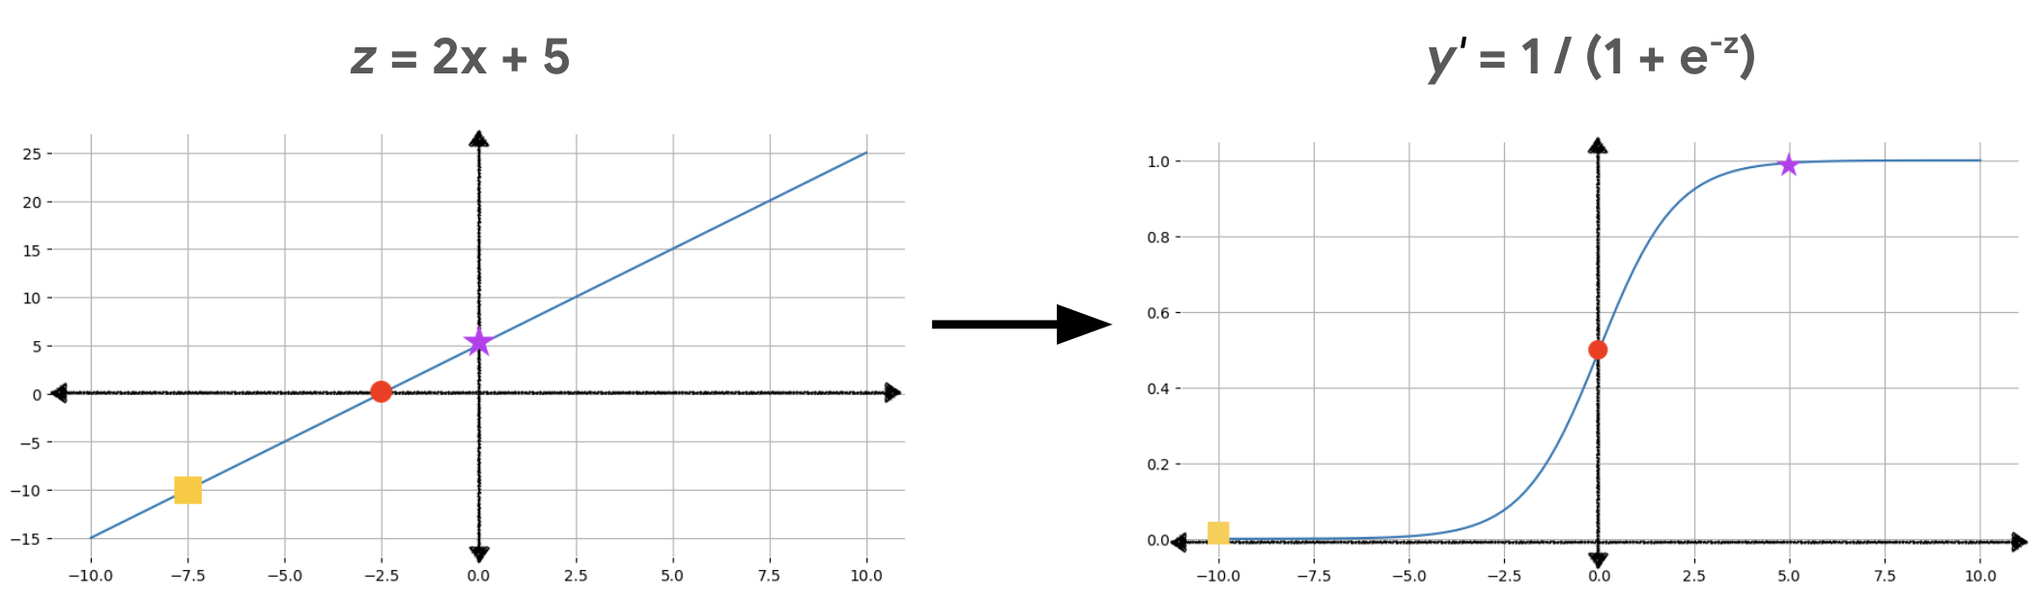
Sigmoid function

Slide 27
How to calculate loss

Slide 28
Classification
If the goal is to output a category
classification model that predicts one of two classes (e.g., "spam" or "not spam").
Type of Supervised learning

Slide 29
How to learn model How to classify?
To use the model for filtering spam, its numerical output must be converted into one of two categories: spam or not spam.
Take the output of the linear regression and make it probability (between 0-1) using logistic regression
This conversion uses a classification threshold

Slide 30
Classification threshold
A value we put identify the interval between the 2 option
If we put the threshold = 0.5
  All the result => 0.5 are positive (spam)
  All the result < 0.5 are negative (not spam)

Slide 31
Confusion matrix
Positive
True positive
Negative
True negative
False positive
False negative

Slide 32
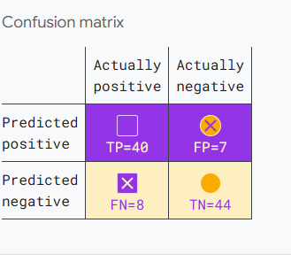
Confusion matrix

Slide 33

The metrics of the Classification
Accuracy
  Measures overall correctness of predictions.
  Formula: $\frac{TP+TN}{TP+TN+FP+FN}$
  Useful for balanced datasets only.
  Can be misleading when data is imbalanced.

Slide 34
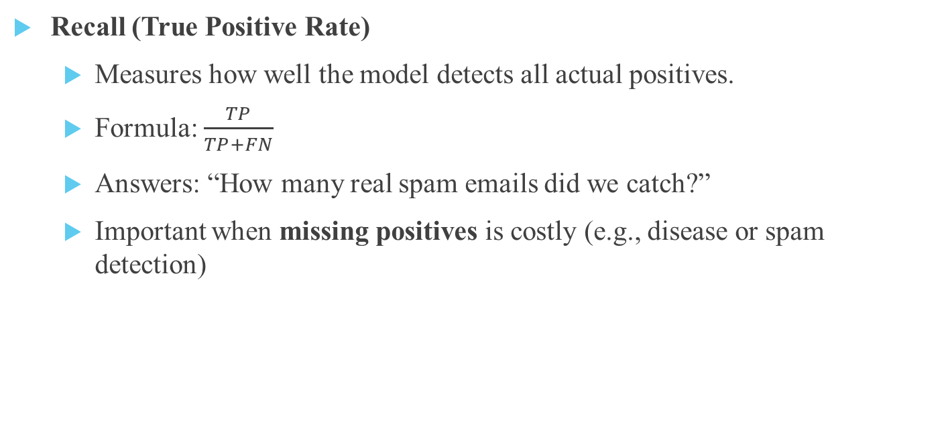
The metrics of the Classification
Recall (True Positive Rate)
  Measures how well the model detects all actual positives.
  Formula: $\frac{TP}{TP+FN}$
  Answers: “How many real spam emails did we catch?”
  Important when missing positives is costly (e.g., disease or spam detection)

Slide 35
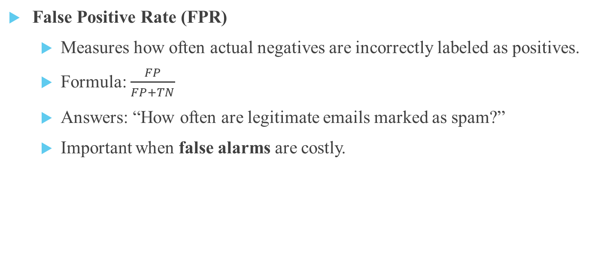
The metrics of the Classification
False Positive Rate (FPR)
  Measures how often actual negatives are incorrectly labeled as positives.
  Formula: $\frac{FP}{FP+TN}$
  Answers: “How often are legitimate emails marked as spam?”
  Important when false alarms are costly.

Slide 36
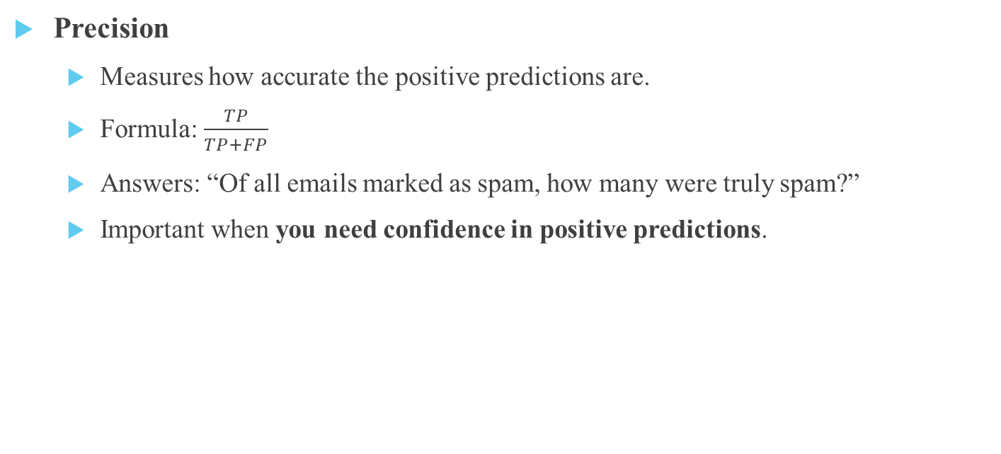
The metrics of the Classification
Precision
  Measures how accurate the positive predictions are.
  Formula: $\frac{TP}{TP+FP}$
  Answers: “Of all emails marked as spam, how many were truly spam?”
  Important when you need confidence in positive predictions.

Slide 37
ROC and AUC
Metrics like accuracy, precision, and recall are calculated at *one specific threshold
But changing the threshold can change the model’s performance
Receiver Operating Characteristic (ROC) Curve
shows how the model’s True Positive Rate (TPR) and False Positive Rate (FPR) change as the classification threshold changes.
Area Under the Curve (AUC)
summarizes the ROC curve into a single number
measures the area under the ROC curve and represents the overall performance of a model

Slide 38
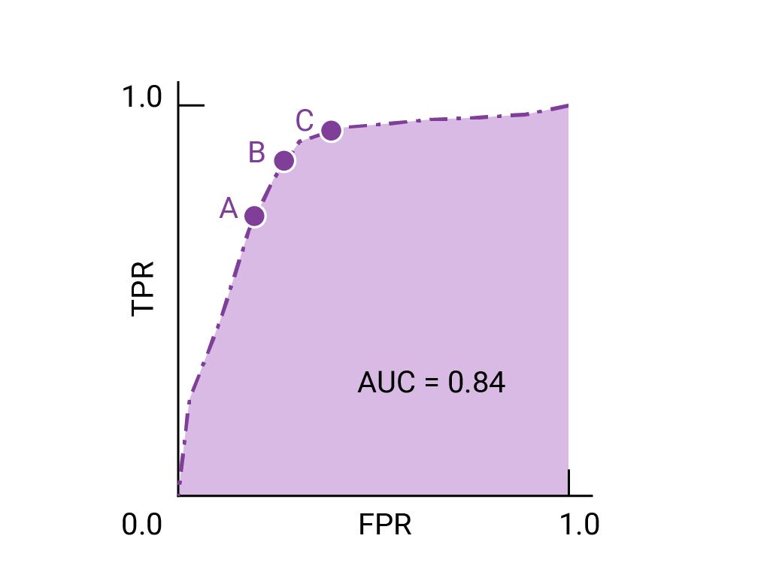
ROC and AUC

Slide 39
Type of Classification
Classification
binary
Multi-Class

Slide 40
Thanks for your attention!!

